Slide 1


Johannes Jaeger
2022/02/22

Slide 2

Outline
Executive Summary
Introduction
Methodology
Results
Conclusion
Appendix

Slide 3
Executive Summary
Data collected via web scraping and REST API, explored via SQL and Visualizations. Interactive data exploration with Folium (for locations) and Plotly Dash. Machine Learning models hyperparameter tuned with GridSearchCV and evaluated via Confusion Matrix
Highest accuracy found in ML model based on Decision Tree Classifier 0.83. Number of flights most critical success factor as proxy to learning curve. Launch locations are set up around the equator and in far distance to high density areas. Inconsistent findings for booster versions, launch sites and orbit types, since results highly dependent on number of flights.

Slide 4
Introduction
The project was initiated to support the evaluation wheter startup SPACE Y should engange in commercial space exploration
The critical success factor in modern space exploration is the capability of the stage 1 booster to return to the launch site safely for re-use, thus dramatically lower the cost per launch
By assessing SpaceX data we calculate the chance of a successful landing and thus are able to predict the expected cost per launch
We try to identify factors (booster type, payload, launch site, orbit, customer, # of launches etc.) leading to a positive/negative launch outcome

Slide 5

Section 1

Slide 6
Methodology
Executive Summary
Data collection methodology:
Data was collected via SpaceX REST API & web scraping Falcon 9 launch records
Perform data wrangling
Data was cleaned, normalized and filtered via Pandas
Perform exploratory data analysis (EDA) using visualization and SQL
Perform interactive visual analytics using Folium and Plotly Dash
Perform predictive analysis using classification models
Hyperparameters of models (LogReg, SVM, Tree and KNN) tuned with GridSearchCV & evaluated with Confusion Matrix

Slide 7
Data Collection
Falcon 9 launch records derived via Wikipedia web scraping
SpaceX data derived via SpaceX REST API
REST API
Web scraping
Open source SpaceX data including launch, rocket, core, capsule, starlink, launchpad and landing pad
Falcon 9 launch records from 2013 to 2019
SpaceX
Wikipedia

Slide 8
Data Collection – SpaceX API
D#: API functions required to access endpoint data for Rockets, LaunchSite, PayloadData and CoreData
Falcon 1 records: excluded
PayloadMass Nulls: replaced by average
Other cleasing: datetime convertion, cores restriction, date restriction, falcon 9 restriction
https://github.com/johannes-jaeger/Data-Science---Capstone/blob/main/Data%20Collection%20API.ipynb
REST API
Open source SpaceX data including launch, rocket, core, capsule, starlink, launchpad and landing pad
SpaceX

Slide 9
Data Collection - Scraping
Define help functions
Parse URL as text
Extract column names
Create data frame by parsing launch HTML tables
https://github.com/johannes-jaeger/Data-Science---Capstone/blob/b167e5c015765e222bde81bea4089a8c710e4d05/Data%20Collection%20with%20Web%20Scraping.ipynb
Web scraping
Falcon 9 launch records from 2013 to 2019
Wikipedia

Slide 10
Data Wrangling
40.63% of LandingPad values missing
Launches per LaunchSite calculation
Launches per Orbit calculation
Mission outcome per orbit type
Landing outcomes converted to 0/1 (not land/land)
https://github.com/johannes-jaeger/Data-Science---Capstone/blob/master/Data%20Wrangling%20-%20EDA.ipynb

Slide 11
EDA with Data Visualization
ScatterPlot "Payload x Launch Site" to identify the impact of the launch site on outcome, depending on Payload
ScatterPlot "Flight Number x Launch Site" to identify if more flights are linked to better outcomes, depending on Launch Site
ScatterPlot "Orbit x Launch Site" to identify if the outcome depends on which Orbit the rocket intersepted, depending on Launch Site
BarChart "Orbit x Outcome" to derive the % of successful outcomes per Orbit
ScatterPlot "Flight Number x Orbit": do subsequents flights into same Orbit have higher success rates?

Slide 12
EDA with Data Visualization
Scatter Plot "Payload x Orbit": are some payloads to heavy for certain Orbits?
LineChart "Outcome x Year": how has the success rate developed over time?
https://github.com/johannes-jaeger/Data-Science---Capstone/blob/master/Data%20Visualization%20-%20EDA.ipynb

Slide 13
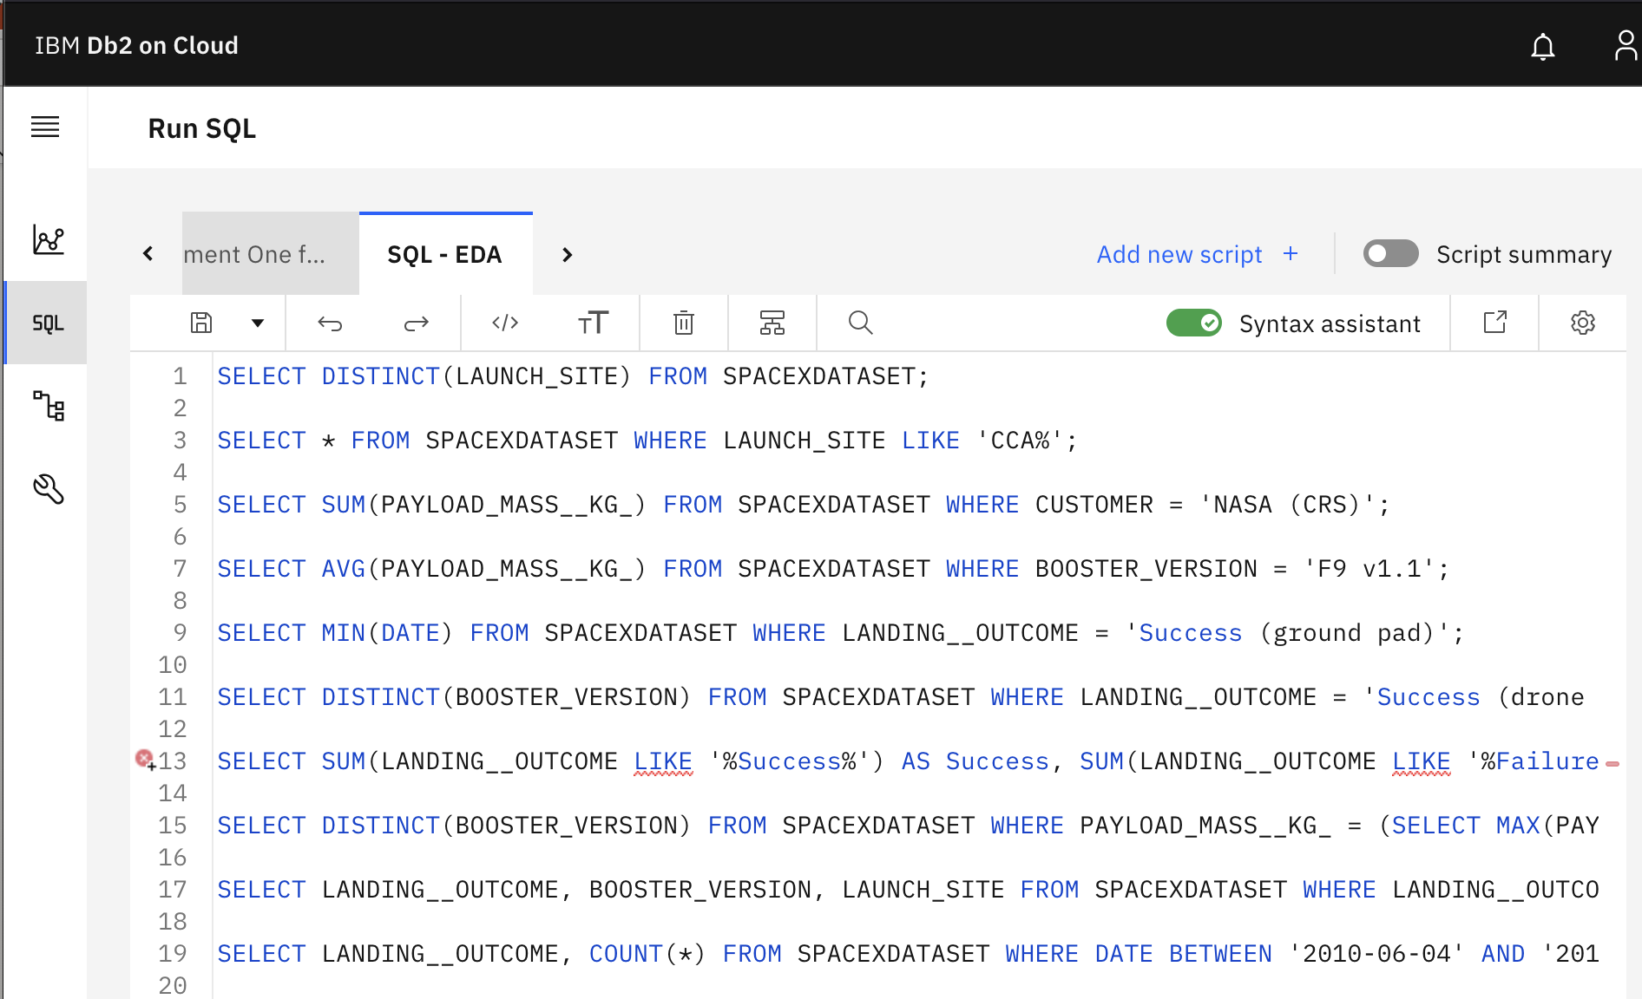
EDA with SQL
No Github URL available since conducted directly in IBM Db2 on Cloud SQL rather than Jupyter Notebook %sql magic sql statements

Slide 14
EDA with SQL
SELECT DISTINCT(LAUNCH_SITE) FROM SPACEXDATASET;
SELECT * FROM SPACEXDATASET WHERE LAUNCH_SITE LIKE 'CCA%';
SELECT SUM(PAYLOAD_MASS__KG_) FROM SPACEXDATASET WHERE CUSTOMER = 'NASA (CRS)';
SELECT AVG(PAYLOAD_MASS__KG_) FROM SPACEXDATASET WHERE BOOSTER_VERSION = 'F9 v1.1';
SELECT MIN(DATE) FROM SPACEXDATASET WHERE LANDING__OUTCOME = 'Success (ground pad)';
SELECT DISTINCT(BOOSTER_VERSION) FROM SPACEXDATASET WHERE LANDING__OUTCOME = 'Success (drone ship)' AND (PAYLOAD_MASS__KG_ BETWEEN 4000 AND 6000);

Slide 15
EDA with SQL
SELECT SUM(LANDING__OUTCOME LIKE '%Success%') AS Success, SUM(LANDING__OUTCOME LIKE '%Failure%') AS FAILURE FROM SPACEXDATASET GROUP BY (LANDING__OUTCOME LIKE '%Success%' OR LANDING__OUTCOME LIKE '%Failure%');
SELECT DISTINCT(BOOSTER_VERSION) FROM SPACEXDATASET WHERE PAYLOAD_MASS__KG_ = (SELECT MAX(PAYLOAD_MASS__KG_) FROM SPACEXDATASET);
SELECT LANDING__OUTCOME, BOOSTER_VERSION, LAUNCH_SITE FROM SPACEXDATASET WHERE LANDING__OUTCOME = 'Failure (drone ship)' AND DATE LIKE '2015%';
SELECT LANDING__OUTCOME, COUNT(*) FROM SPACEXDATASET WHERE DATE BETWEEN '2010-06-04' AND '2017-03-20' GROUP BY LANDING__OUTCOME ORDER BY COUNT(*) DESC;

Slide 16
Build an Interactive Map with Folium
Markers and Circles on NASA, JSC and launch sites
Marker Cluster (number of launches) and add icon label for launch outcomes (success / fail) per launch site
markers and lines for closest coastline, city, railroad and highway
The visualization of locations of launch sites + respective launch numbers + outcomes and distance from coastline, highways, railroads and cities gives us a better understanding about the underlying mechanisms that impact the set up of a launch site
https://github.com/johannes-jaeger/Data-Science---Capstone/blob/master/Interactive%20Visual%20Analytics%20-%20Folium.ipynb

Slide 17
Build a Dashboard with Plotly Dash
Pie chart showing the share of each launch site of total success counts
Pie chart showing success rate % per launch site
Interactive Scatter Plot showing the impact of different Payload Mass (kg) ranges on Outcome under consideration of different Booster Versions
The graphs allow us to identify unique patterns for Payload Mass (kg) & Booster Version on Outcome and generally provide a good overview regarding frequency and success rate of different launch sites
Add the GitHub URL of your completed Plotly Dash lab, as an external reference and peer-review purpose

Slide 18
Predictive Analysis (Classification)
Data pre-processing involved setting the outcome table Y df.to_numpy() array (less memory space and better runtime speed) and normalize input variables X via .StandardScaler() "resize distribution of values so that the mean of obsered values is 0 and the standard deviation is 1" and .fit().transform() so "our model is not biased towards a particular feature of the dataset and at the same time prevents our model to learn features of our test data"
Train_test_split to divide the data into train 0.2 and test data 0.8
Various ML models (LogReg, SVM, Tree, K-nearest Neighbors) werde deployed
The optimum parameters for each model identified via GridSearchCV hyperparameter tuning
Overall Train-set & test-set accuracy evaluated via accuracy score .best_core & .score
Confusion Matrix used to further analyze false-positive & false-negative
https://github.com/johannes-jaeger/Data-Science---Capstone/blob/master/Machine%20Learning%20Prediction.ipynb

Slide 19
Results
Exploratory data analysis results
Interactive analytics demo in screenshots
Predictive analysis results

Slide 20

Section 2

Slide 21
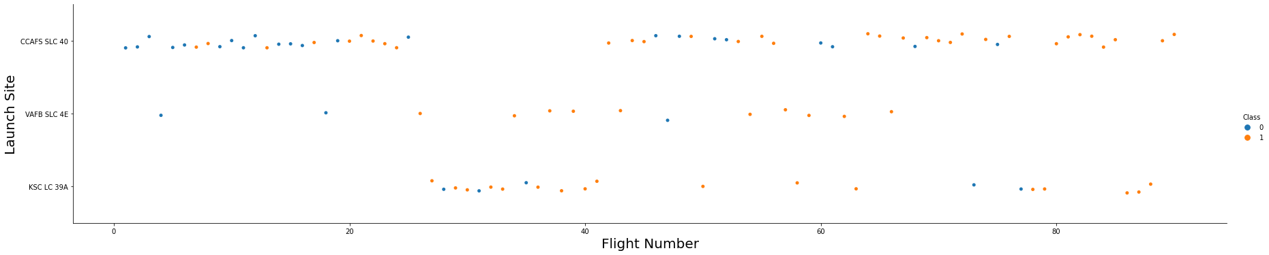
Flight Number vs. Launch Site
Once the threeshold of ca. 30 flights is reached the likelihood of a successful outcome increases substantially, thus leading to a high entry barrier considering the associated sunk cost of those failed launches. Starting from around 80 flights SpaceX reached a 100% success rate

Slide 22
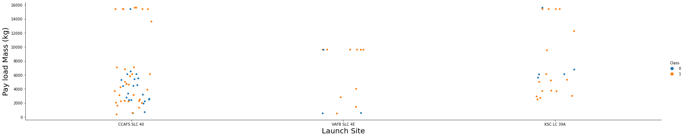
Payload vs. Launch Site
The higher the payload (above ca. 8,000 kg), the higher the success rate. However, below 8,000 kg we can´t find a clear trend. Probably higher payloads were tested at later stages, which would imply that flight number and not payload is the determining factor

Slide 23
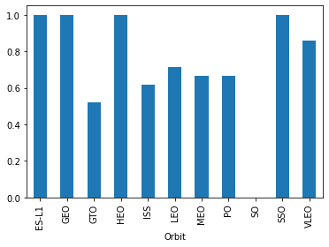
Success Rate vs. Orbit Type
ES-L1, GEO, HEO and SSO have the highest success rates

Slide 24
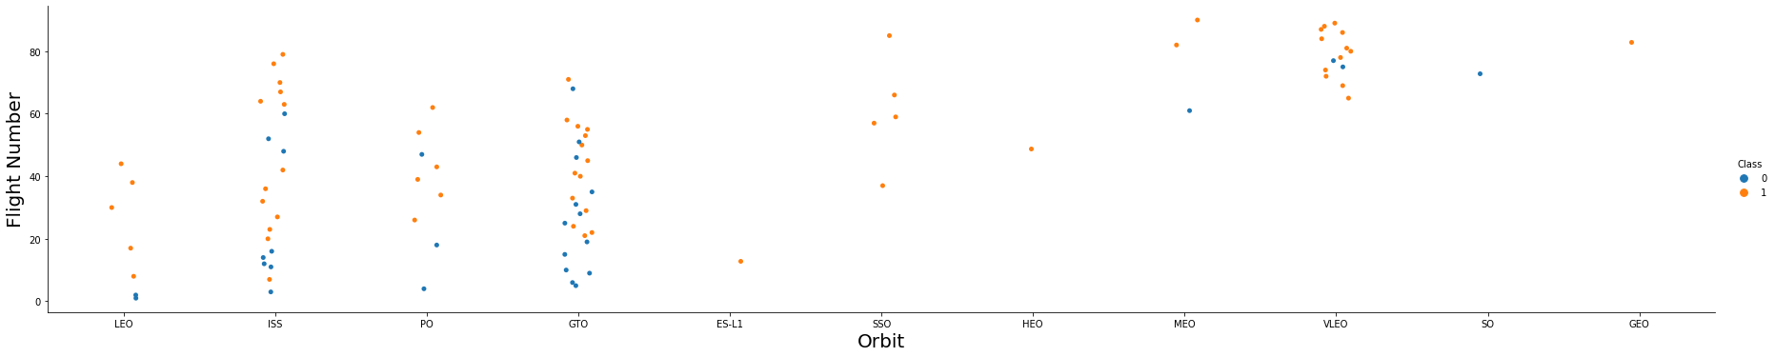
Flight Number vs. Orbit Type
Most flights were launched into GTO and ISS orbits. At a later stage, SpaceX focused more on VLEO. For Leo, subsequent flights had a higher success rate, whereas no pattern can be identified for other orbits

Slide 25
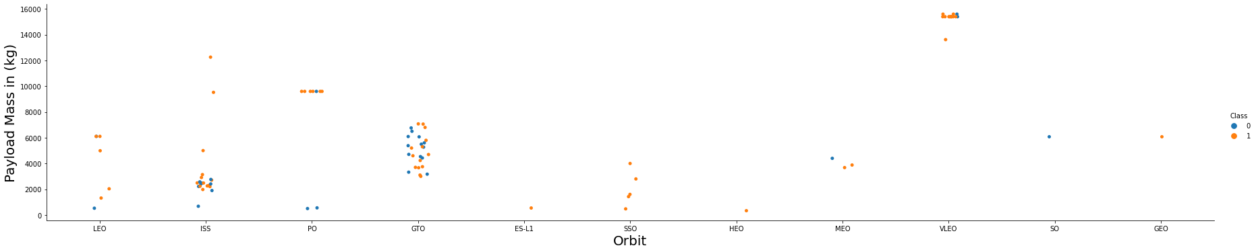
Payload vs. Orbit Type
LEO, ISS and PO seem to better suited for higher payloads, no clear pattern identifiable for other orbits

Slide 26
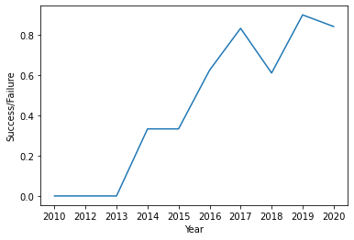
Launch Success Yearly Trend
There is a 2-year epidose of failed launches from 2010 – 2012. Starting from 2013 the success rate trend is positive with reaching it´s peak in 2019 before dipping slightly

Slide 27
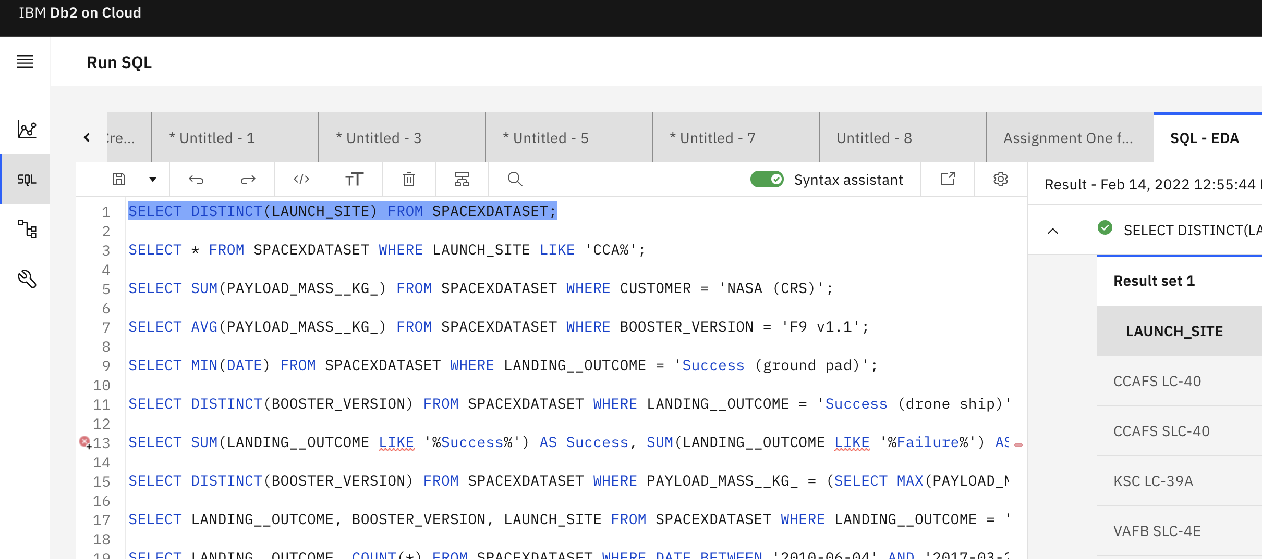
All Launch Site Names
4 unique Launch Sites derived via DISTINCT-statement

Slide 28
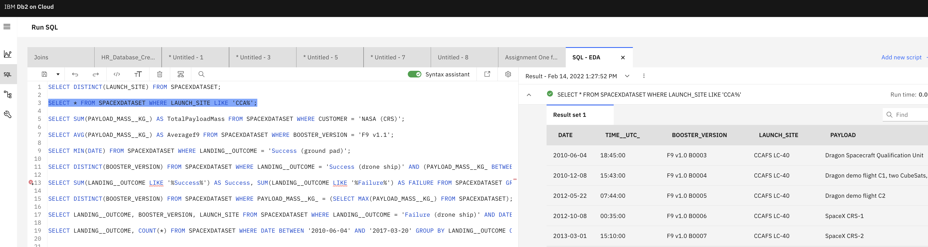
Launch Site Names Begin with 'CCA'
LIKE "%" statement used to derive Launch Sites beginning with "CCA"

Slide 29
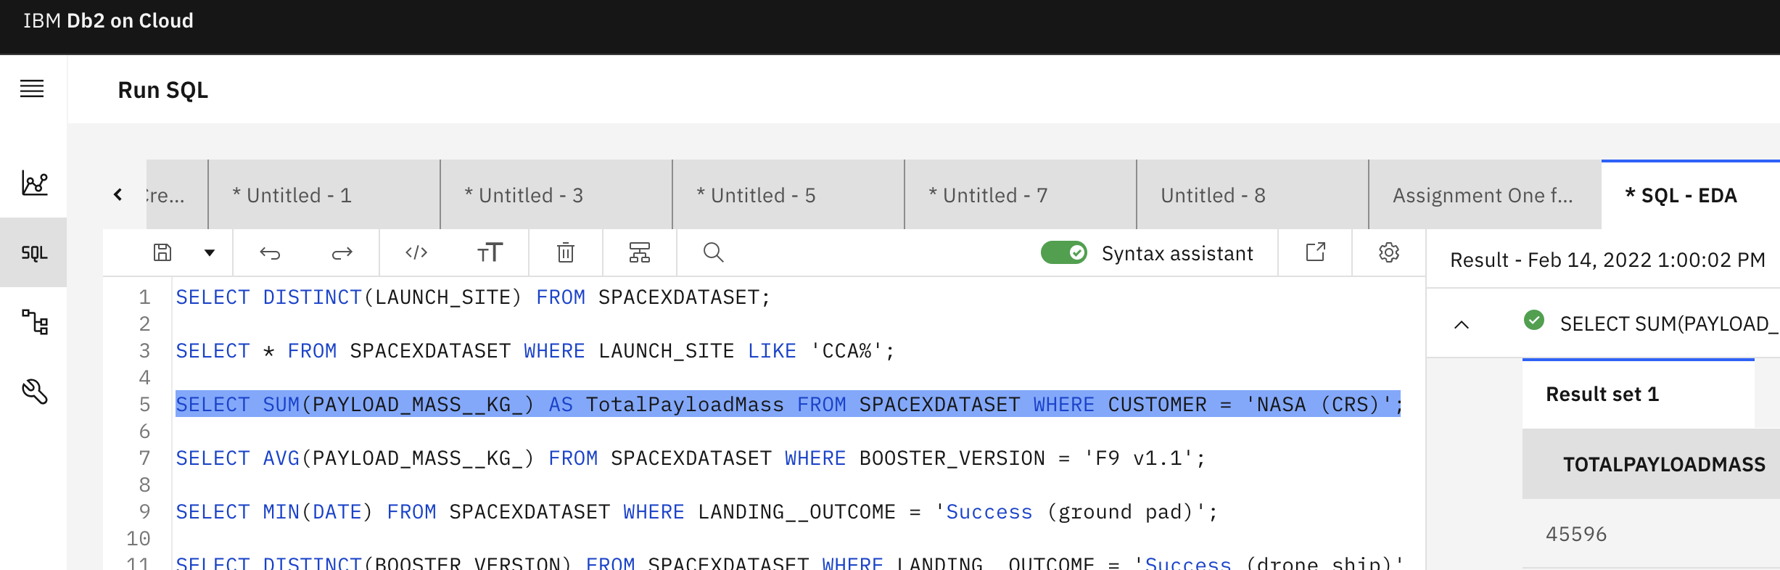
Total Payload Mass
Total Payload Mass derived by using SUM-statement and limiting customer to "NASA (CRS)"

Slide 30
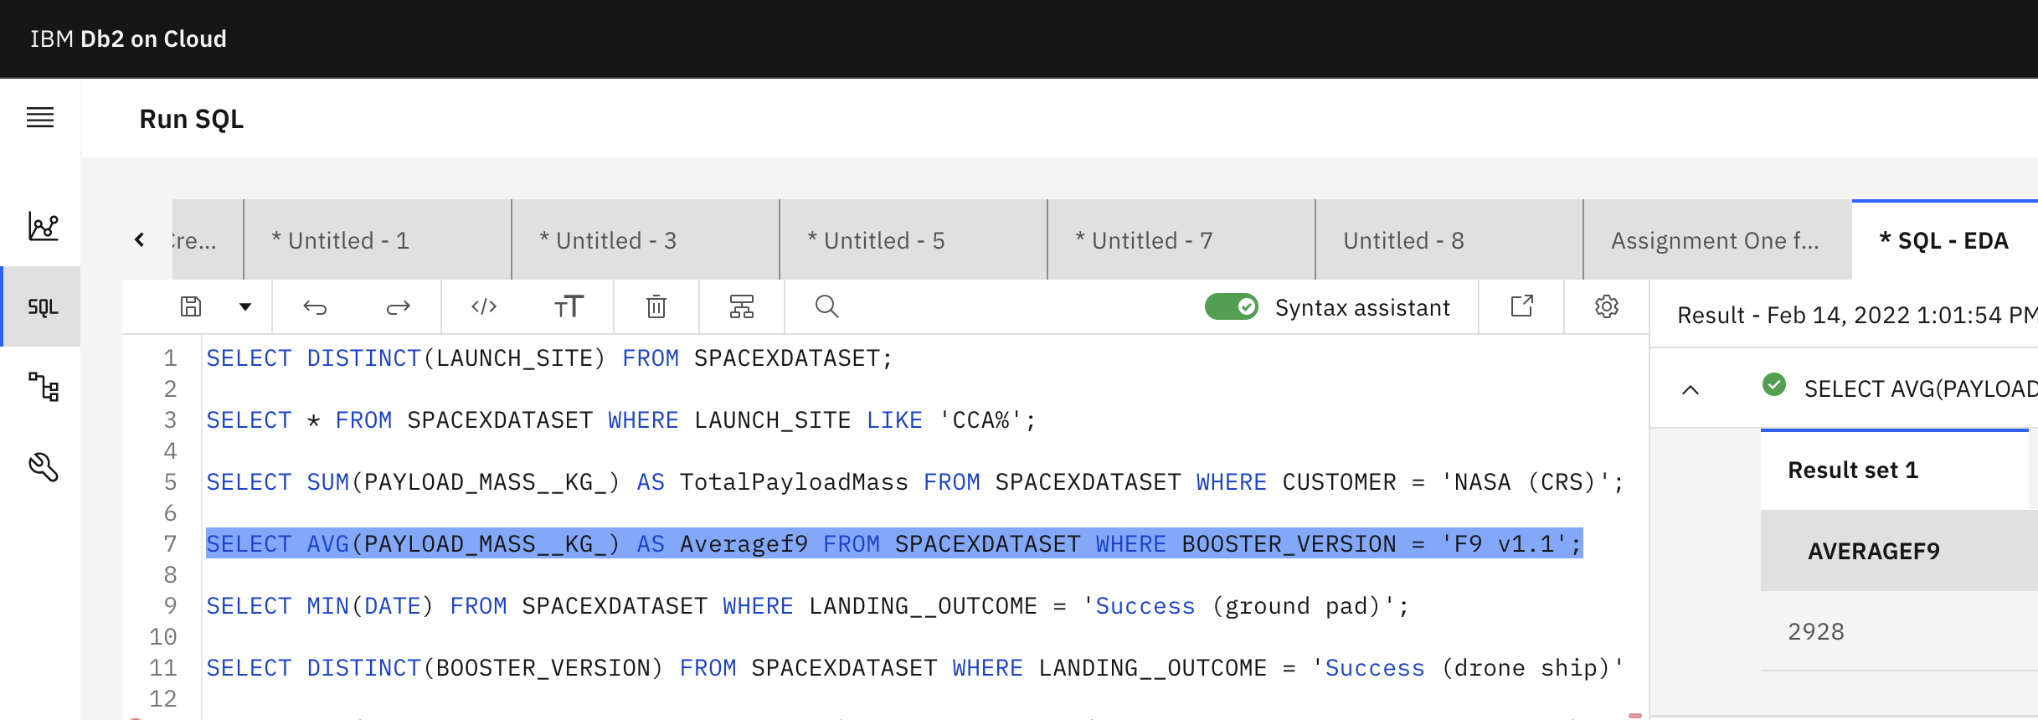
Average Payload Mass by F9 v1.1
AVG-statement used and results limited to Booster Version F9 v1.1

Slide 31
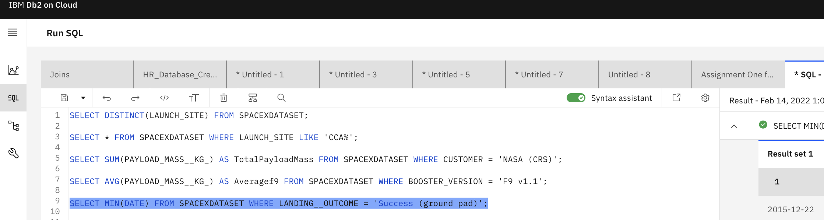
First Successful Ground Landing Date
MIN-statement used in combination with DATE and results limited to "Success (ground pad)"

Slide 32
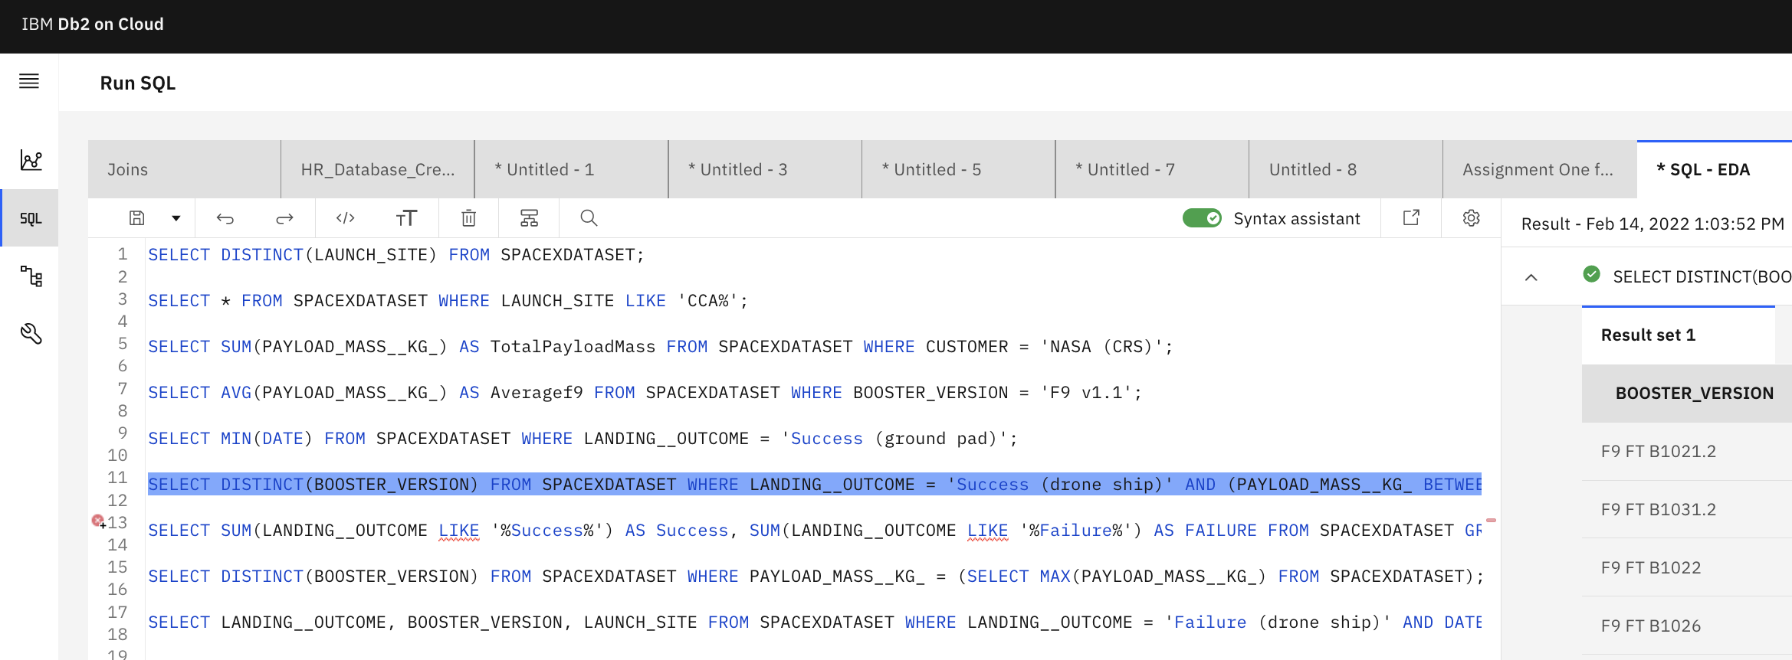
Successful Drone Ship Landing with Payload between 4000 and 6000
DISTINCT statement combined with limiting results to "Success (drone_ship)" and PAYLOAD_MASS_KG_ restriction

Slide 33
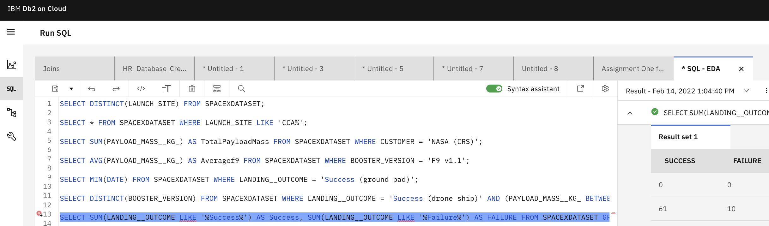
Total Number of Successful and Failure Mission Outcomes
LIKE "%" statement set for successful and failure launches and group-by accordingly

Slide 34
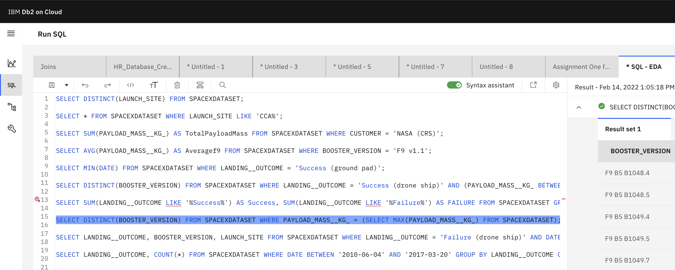
Boosters Carried Maximum Payload
Sub-query used to find the maximum Payload and combined with DISTINCT-statement

Slide 35
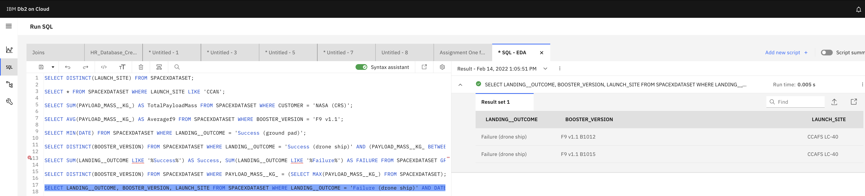
2015 Launch Records
LANDING__OUTCOME combined with DATE restriction 2015 to limit results

Slide 36
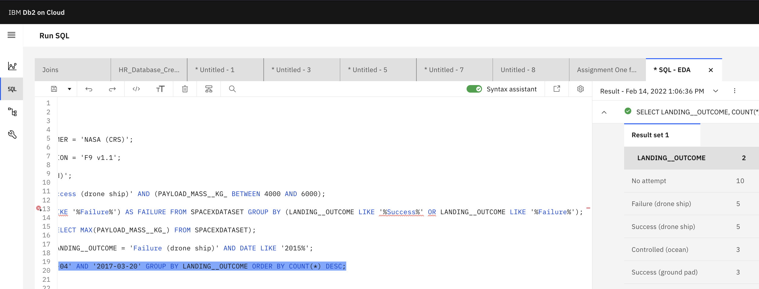
Rank Landing Outcomes Between 2010-06-04 and 2017-03-20
ORDER BY COUNT(*) DESC used to rank the results by number of Landing Outcomes

Slide 37

Section 3

Slide 38

Location of Launch Sites
The launch site locations are built on the coastline in the south part of the United States due to close proximity to the equator, leading to better operational performance regarding efficiency and cost.

Slide 39
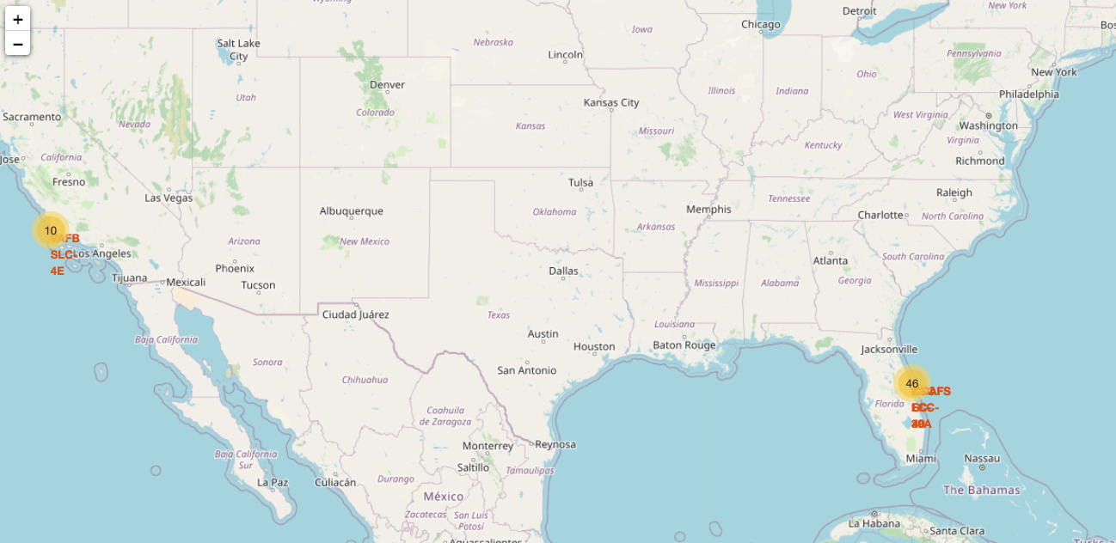

Success/failed launches per Launch Site
The number of launches is added as a layer to the map with respective layer icons, representing positive or negative launch outcomes per site.

Slide 40

Distance launch site to proximities
The graphic represents the distance of launch site CCAFS SLC-40 from the coastline, 0.9 KM. Close proximities can be also discovered towards railroads and highways. However, launch sites are built far away from cities due to safety, noise and environmental aspects

Slide 41

Section 4

Slide 42
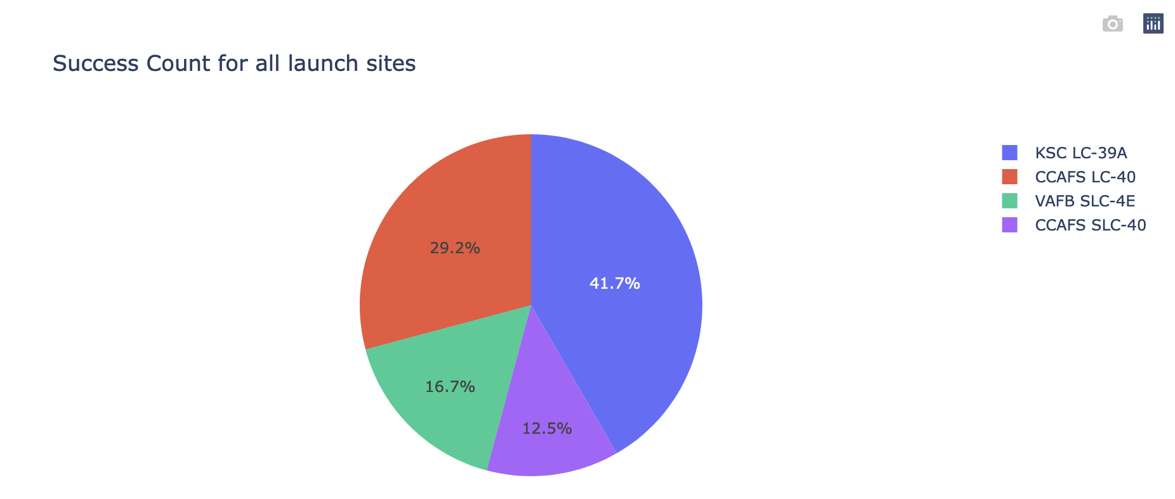
Share of Total Successful Launches per Launch Site
KSC LC-39A accounts for 41.7% of successful launches, but only achieves 23.1% success rate, implying that just the number of launches is highest
The opposite for CCAFS SLC-40 & VAFB SLC-4E with 12.5% & 16.7%, respectively, but high individual success rate of 42.9% & 40%, respectively

Slide 43
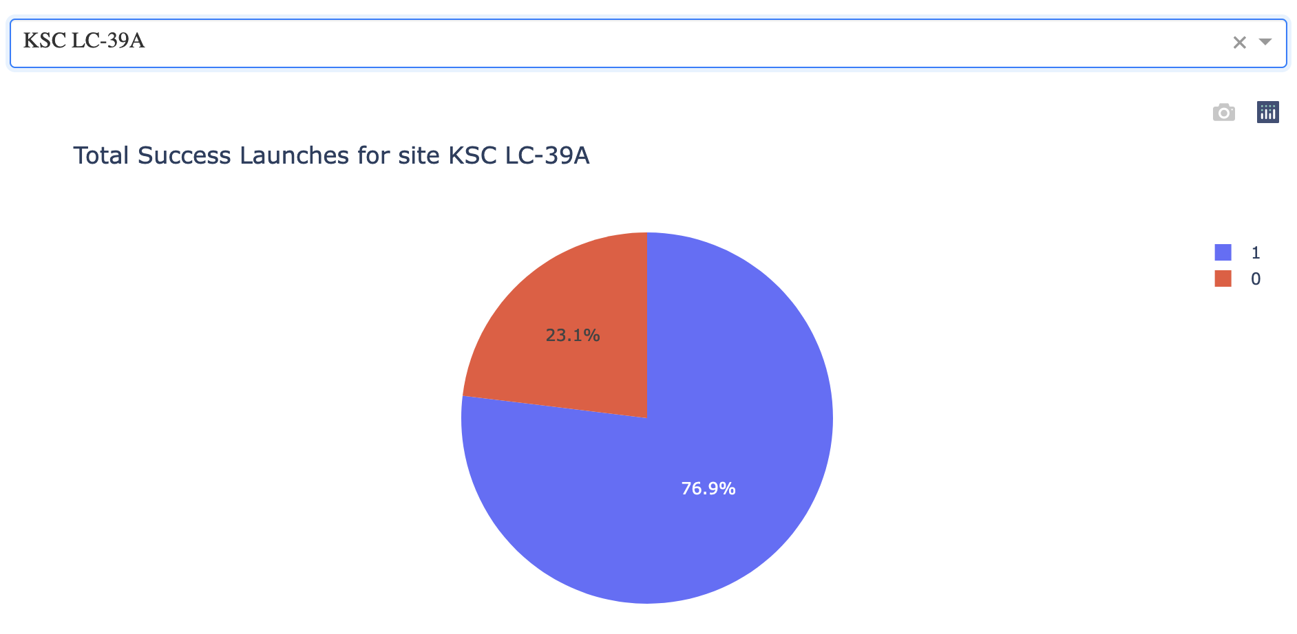
Success rate % per Launch Site
CCAFS LC-40 73.7%
VAFB SLC-4E 60 %
KSC LC-39A 76.9 %
CCAFS SLC-40 57.1%

Slide 44
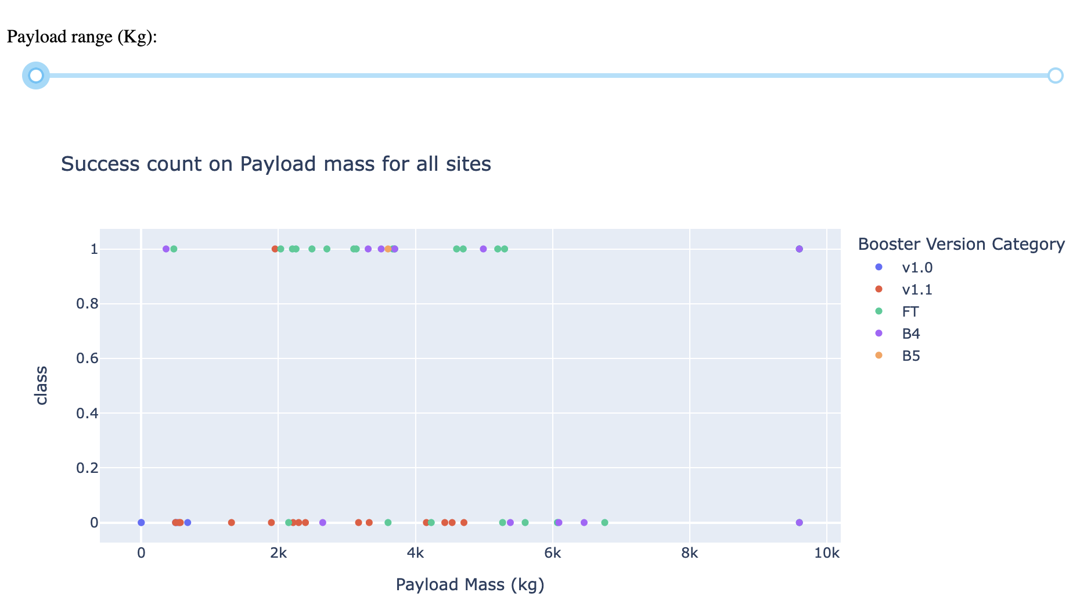
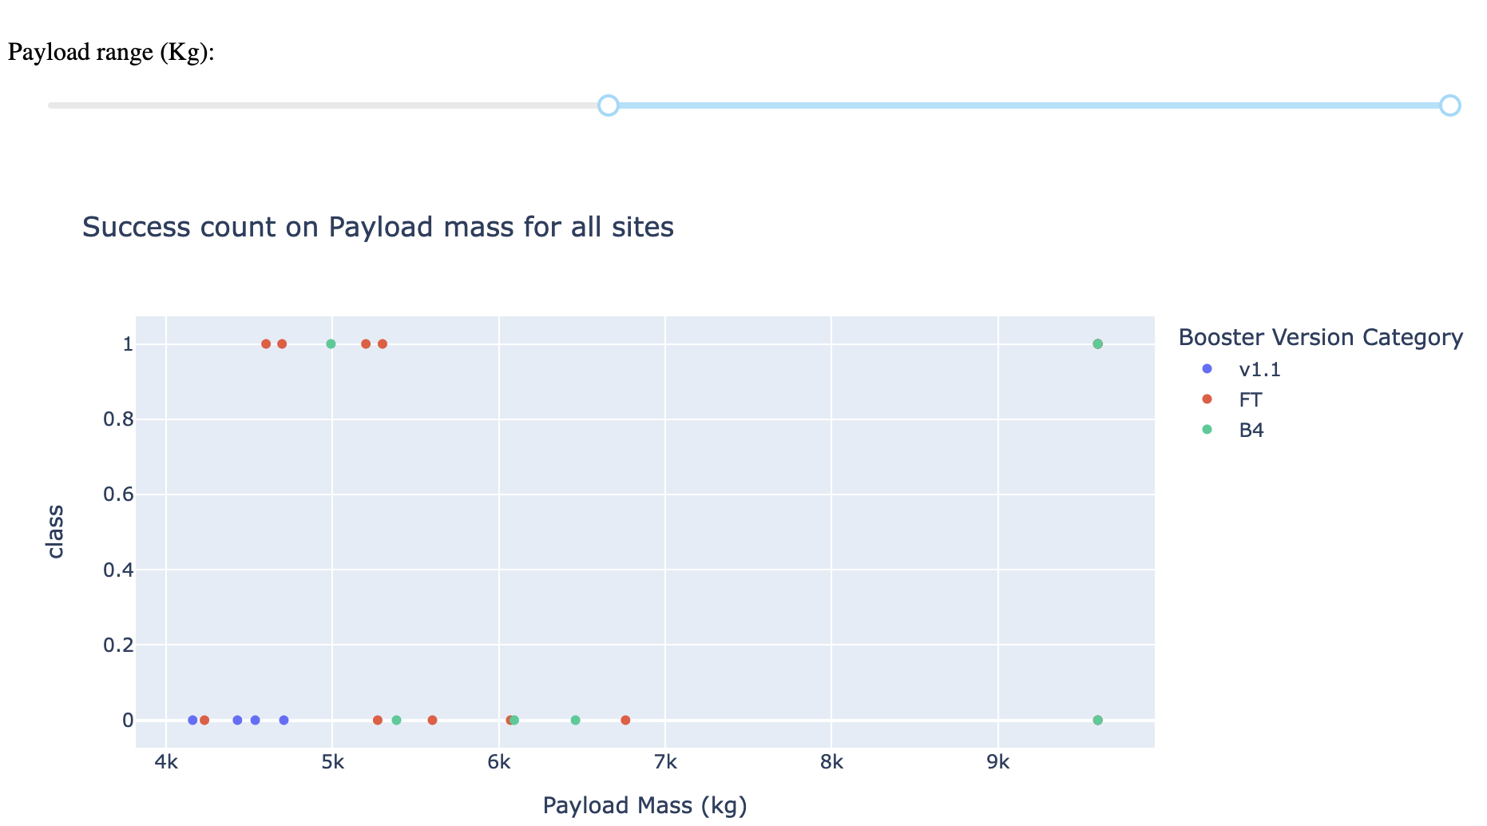
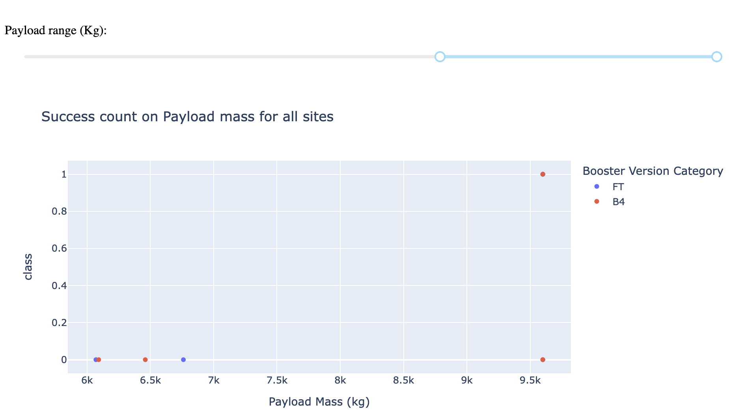
Launch Outcomes for increasing Payloads
No unique pattern can be identified for payloads below 2,000kg due to mix of booster version and limited FT and B4 data
v1.1 boosters fail constantly with only 1 successful landing., V1.0 never managed any successful landing and B5 was only tested once (outcome: success). F5 & B4 boosters seem to be overall better booster version, however, the suitability of each depends on the payload as follow:
FT rockets seem to be more suitable for payloads up to 3,500 kg
B4 rockets seem to be more suitable for payloads up to 5,000 kg
Oerall success rate declines dramatically above 6,000 kg with only one single successful launch accomplished

Slide 45

Section 5

Slide 46
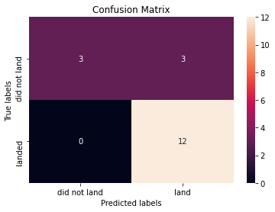
Confusion Matrix
Same Confusion Matrix for all models

Slide 47
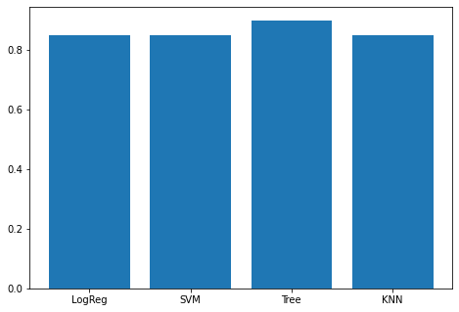
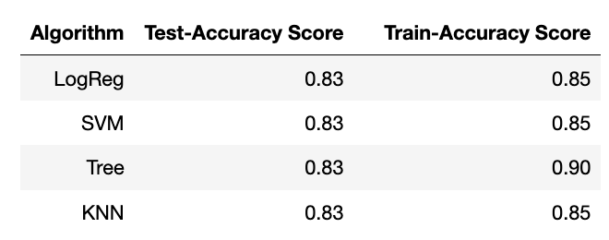
Classification Accuracy
Decision Tree Classifier reaches highest accuracy on train set with 0.90. However, we trained the models and all of them let to a Test-Accuracy-Score of 0.83

Slide 48
Conclusions
Orbit SSO seems to be a safe flight distance for lower payloads without any failed launch. VLEO, PO, ISS and LEO seem to be safe flight distances for higher payloads
The success rate improved fundamentally over time and a close to 100% success rate can be expected in the future
KSC LC 39A has the highest success rate. However, it seems the number of flights is a more relevant factor and KSC LC 39A just happens to be the last launch site added to the test (at around 30 launches) and thus benefitting from lessons-learned of previous launches
Decision Tree Classifier represents the best Machine Learning Model for the SpaceX dataset

Slide 49


